Slide 1
Air Traffic Control

Slide 2
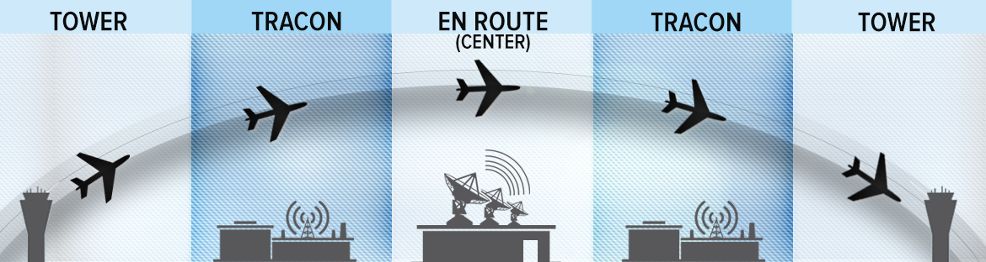
ATC Types

Slide 3

Tower ATC

Slide 4
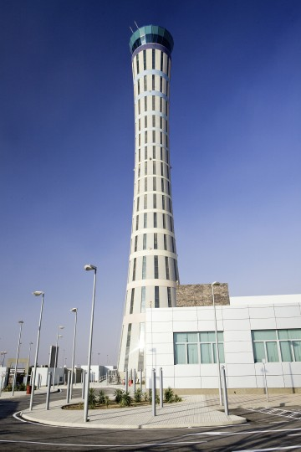
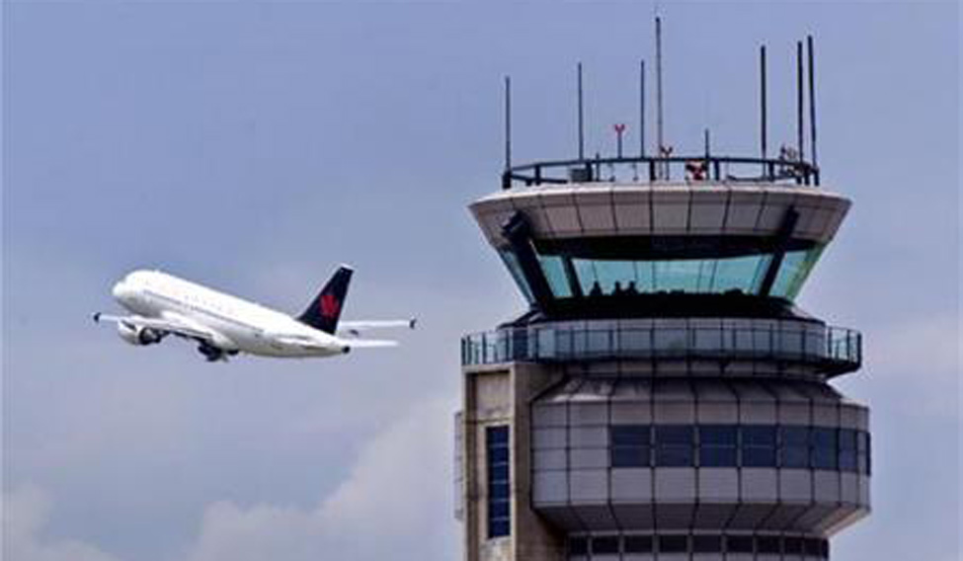
Tower ATC

Slide 5
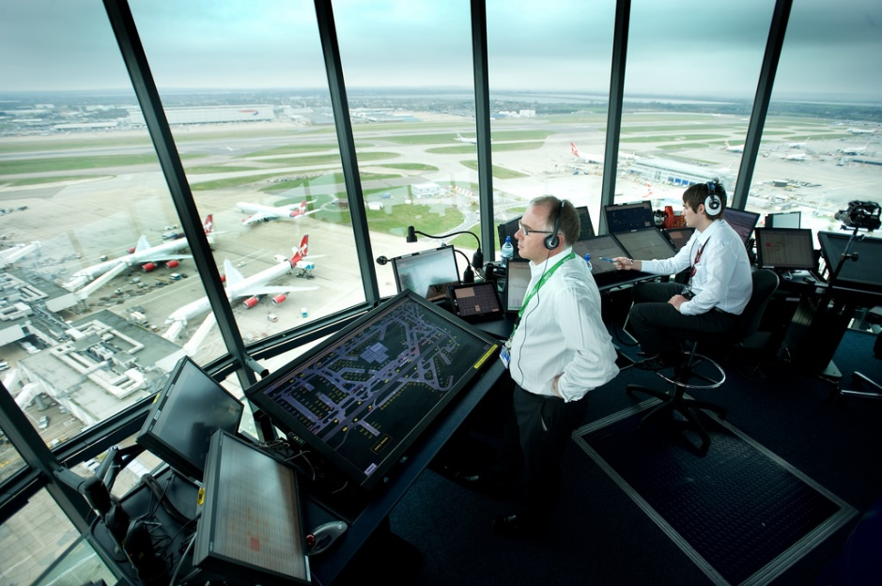
Tower ATC

Slide 6
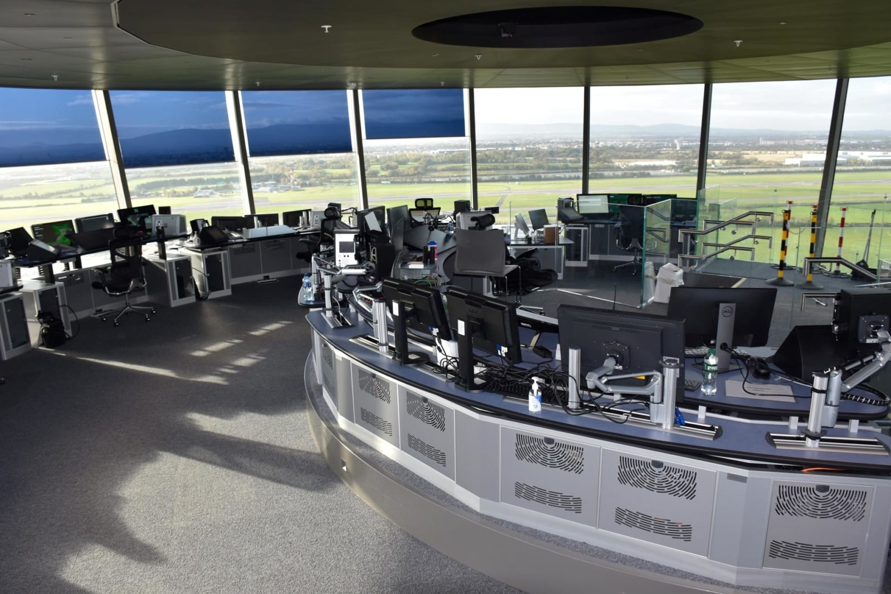
Tower ATC

Slide 7

Approach ATC

Slide 8

Approach ATC

Slide 9
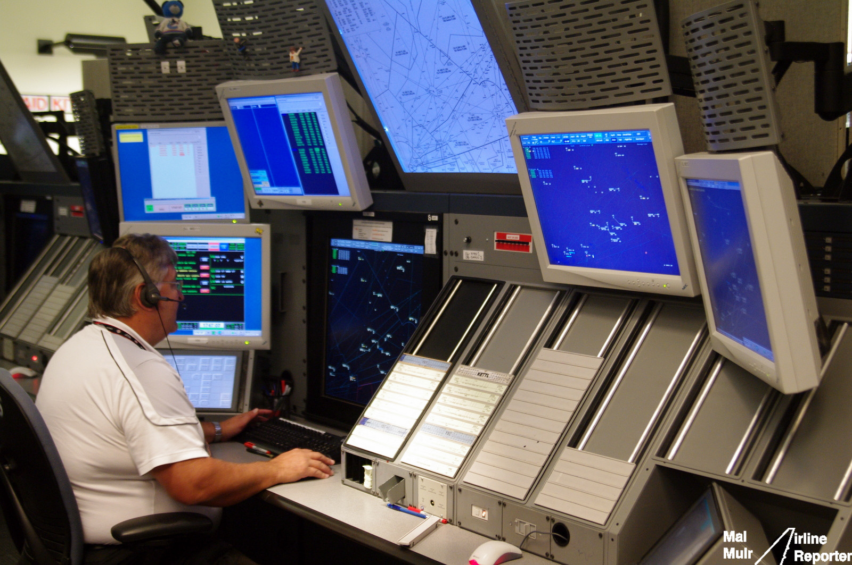
Approach ATC

Slide 10
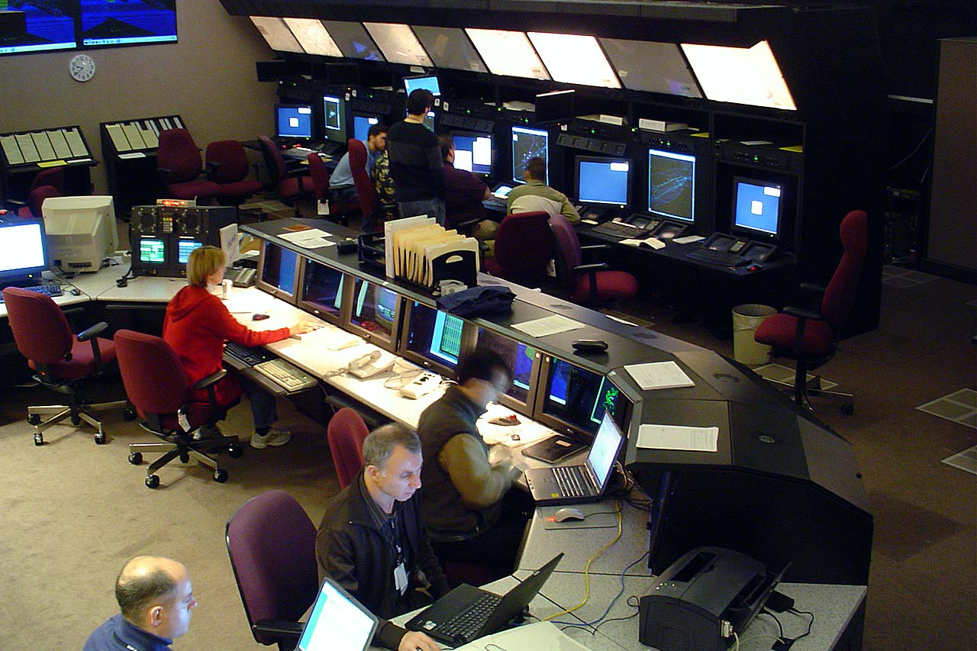
En-route ATC

Slide 11

En-route ATC

Slide 12

Approach ATC Again

Slide 13
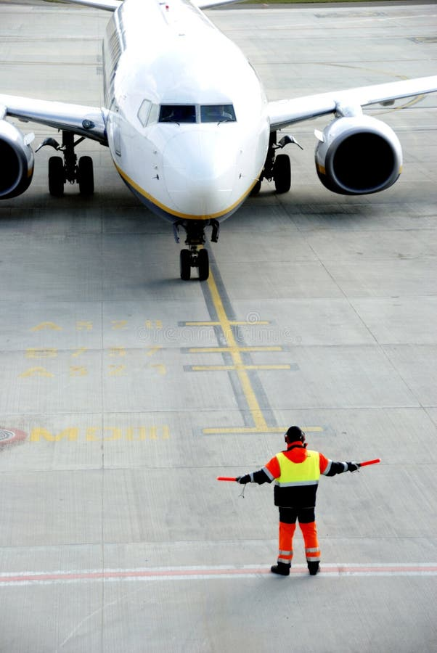

Tower ATC Again

Slide 14
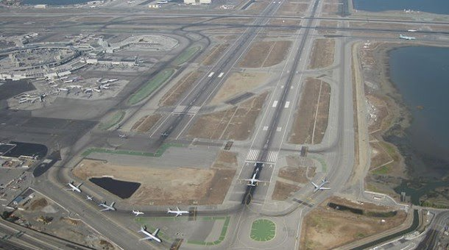
Tower ATC Again

Slide 15
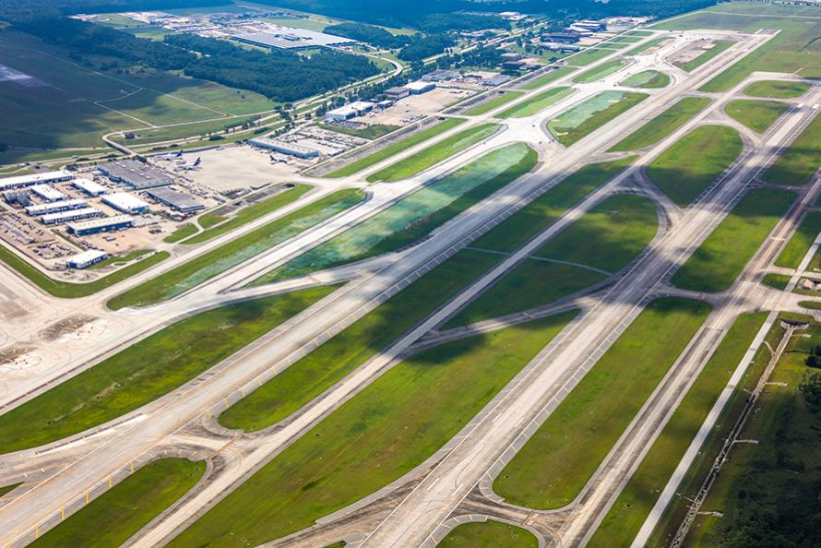
Tower ATC Again

Slide 16
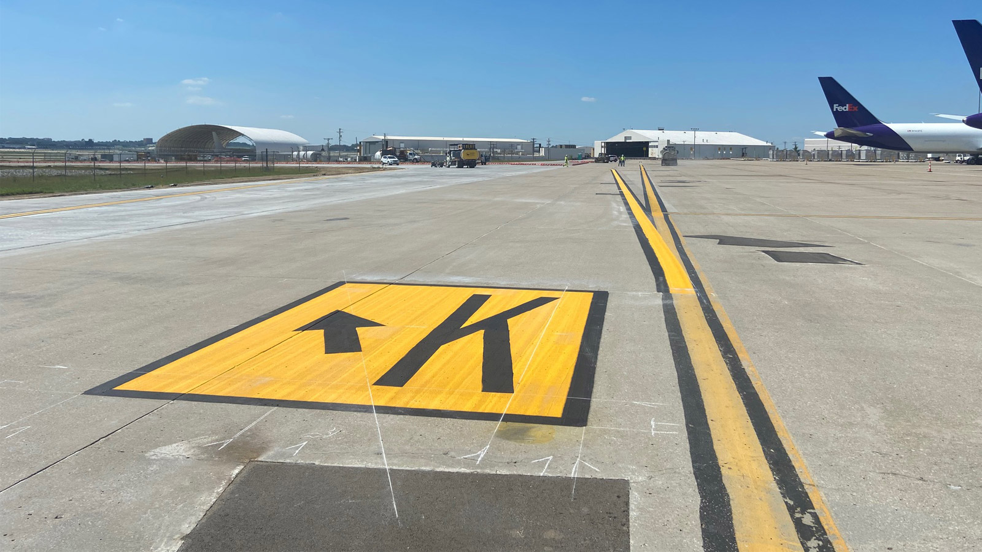
Tower ATC Again

